Slide 1
Spoofing Identity
Romek Szczesniak

Slide 2
Submitting your Details
Do you feel aggrieved at typing in your info?
Could you enter in fake details?
What happens if you do?
Does anyone check you are real?
Or your address, postcode, country, …?
Or your US state?

Slide 3
Weasel Words
I do not recommend or condone any of the following I am about to show you
Any methods presented are for illustrative reasons only

Slide 4
How Do I Fake Who I Am?
Forms – sign up as someone else
Blogs – set up as someone else
Catfish – appear to be somebody else
Hiding my IP Address
Hiding my geographic location
Credit Cards – Creating A Fake Card
Offline Spoofing
How Do We Stop This?

Slide 5
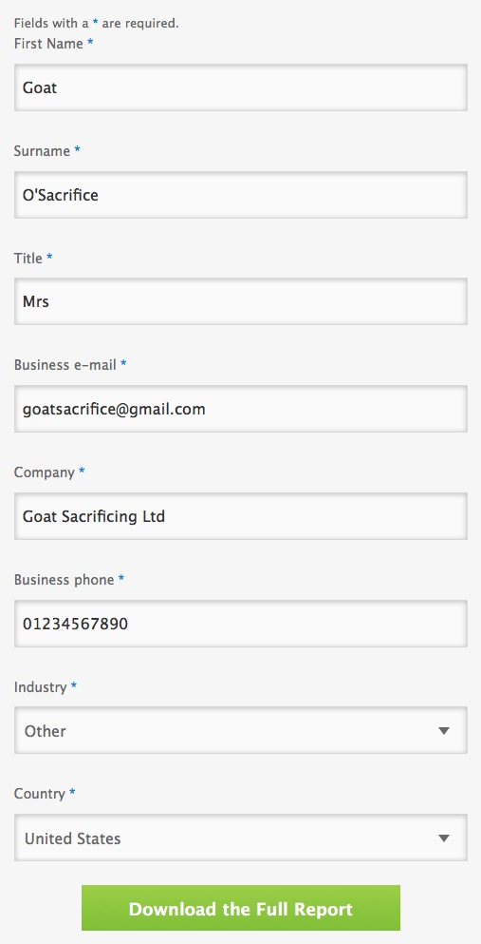
Forms
There is nothing stopping you entering anything in a web form
No checks at all!
Any correct info supplied is voluntary
A valid email only is needed here

Slide 6
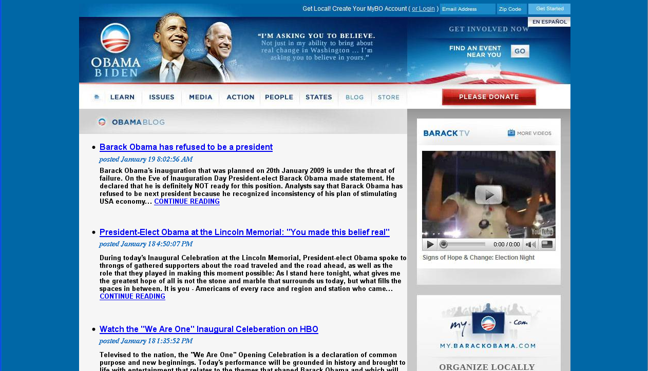
Blogs
Anyone can set up a blog about anyone
These sites usually contain fake links and malware

Slide 7
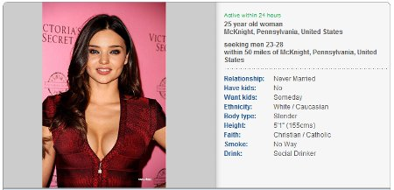
Catfishing
Someone who pretends to be someone they're not using social media to create false identities, particularly to pursue deceptive online romances
Create a profile on a site as somebody else
Act as that person
Typically used in dating / personals sites
How can you tell someone is fake?
  Too good to be true – look too pretty, have just the things you are looking for, etc.
  Bad quality photos or none at all, no webcam
  In a hurry to obtain your trust
  Have monetary reasoning for gaining your trust

Slide 8
Hiding My IP Address
Check IP address on WhatIsMyIPAddress.com
Hide your IP address as follows:
  Use free Wi-Fi away from home
  Tor and Onion Routing
  Use a Trusted Proxy or Virtual Private Network (VPN)
How can others tell?
  See everything about you at https://ipleak.net/

Slide 9
Hiding My Location
Take a phone, root it, move location
You can pretend to be in any location
How can others tell?
  Use geolocation database providers to determine a users location (e.g. Quova, Maxmind).
  Not foolproof.
  Far from perfect at geolocation.

Slide 10
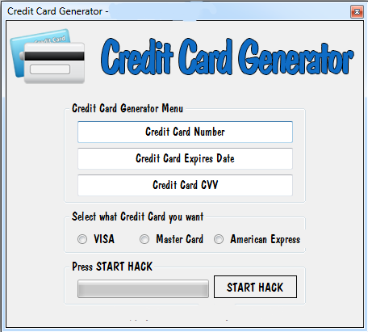
Credit Cards
Create a credit card. Use it online
  This is illegal, but can be done.
  Create test cards with sites like http://www.getcreditcardnumbers.com/
How do we detect it?
  Only banks issue CVV numbers for cards

Slide 11
Offline Spoofing
Need to hide offline identity
Then hide online identity
Two levels make it harder!

Slide 12
How to Avoid Spoofing?
Offline identity MFA requirement
Online identity MFA requirement
Biometric MFA requirement
So you are trying to spoof for example a passport, your biometrics and online login multiple times!
This is really tough to do!

